Slide 1
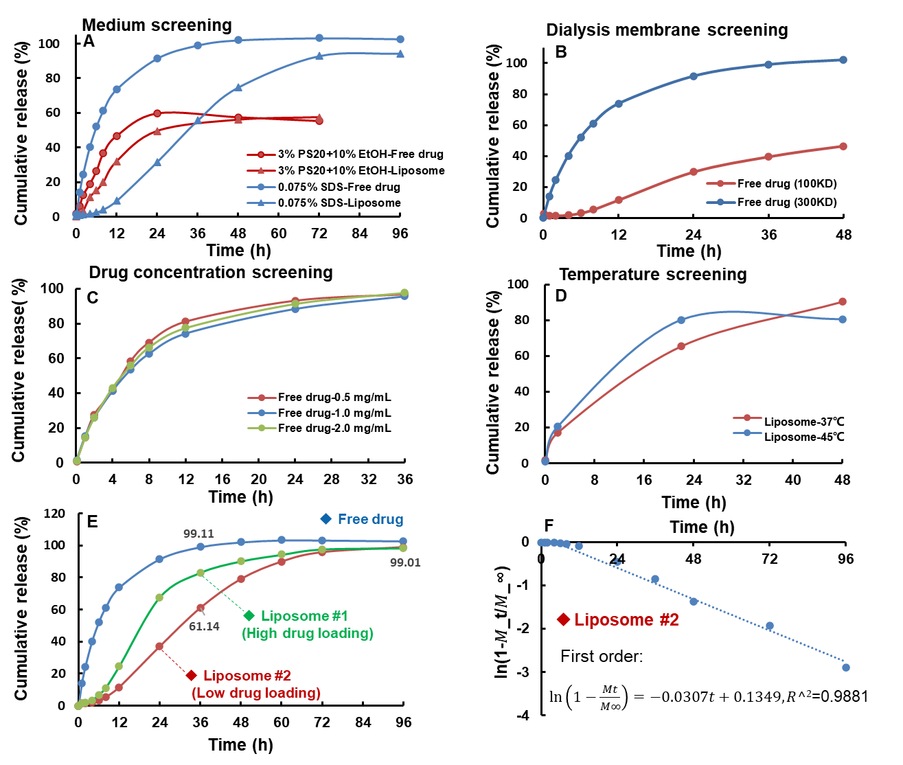
In-vitro release method development for liposomal drug formulations based on USP-IV method
Liang Mao, Lu Tian, Chen Li, Sheng Hu, Jing Li, Shuyao Ruan, Ying Dong, Ruyue Yu
STA Pharmaceutical Co. Ltd
CONTACT INFORMATION: STA Pharmaceutical Co. Ltd., 195 Rijing Rd, Pudong, Shanghai, China, mao_liang@wuxiapptec.com
PURPOSE
Results
Conclusion(S)
The liposomal drug formulations have attracted enormous attention in recent years, owing to a great deal of advantages such as improving drug solubility, decreasing drug toxicity, prolonging circulation time, and the controlled release kinetics (1). The In-vitro release profile of liposomal drug plays a crucial role in formulation development, quality control, and the in-vitro in-vivo correlation (IVIVC) study. However, up to now, there isn’t a well-established in-vitro release method for liposomal formulations with hydrophobic drugs, which maybe derives from the structural complexity of liposomes and low aqueous solubility of loaded drugs(2). There is a pressing demand for developing a universal in-vitro release method. Here, we present the detailed method development of liposomal formulations for hydrophobic drugs based on USP-IV method (Flow-Through Cell method).
After screening a variety of solvent systems (Table 1), 0.075% SDS in PBS buffer was selected due to a relatively higher solubility (240 μg/mL) of Compound X and good liposome stability with no significant increase of particle size and Polydispersity Index (PDI) within 24 hours, indicating that liposome could maintain its structure integrity. Based on the releasing results in different conditions, we could conclude that: (1) 0.075% SDS dissolution medium promotes the release of drug and increases the discrimination power between free drug and liposome compared to other dissolution medium (Figure 1A); (2) 300 KD dialysis membrane is more suitable for release (Figure 1B); (3) the drug concentration (0.5 to 2.0 mg/mL) has no impact on the release profiles (Figure 1C ); and (4) API is stable at 37℃ for release (Figure 1D). Therefore, 1 mg/mL of drug (drug loaded in liposome, and free drug as control) was loaded in the 300 KD dialysis tube with 99 mL 0.075% SDS solution as release medium at 37℃. In control groups, Compound X could be released more than 99% in 0.075% SDS dissolution medium within 36 hrs (74% within 12 hrs). The slower release was observed in liposome group: 9% was released for 12 hrs, 61 % for 36 hrs and 99% for 96 hrs (Figure 1E red line). Furthermore, the developed release method can easily distinguish liposome formulations with different drug loading (Figure 1E), and the release profile can also be fitted with the First Order Equation indicating that the in-vitro release of liposome conforms to the sustained release standard (Figure 1F).
We established a general experimental procedure for in-vitro release method development of liposome loading low solubility drug from this case. The selected dissolution method can discriminate between free drug and different liposomal formulations. Liposome has an apparent sustained release effect compared with free drug. We’ll verify the general method based on more cases and establish IVIVC models with the in-vivo PK data for further investigation.
Table 1. Solubility of Compound X in PBS with different vehicles
Medium | Solubility (μg/mL)
15% EtOH in PBS | <0.1
10% Glycerin in PBS | <0.1
0.1% Dimethylacetamide in PBS | <0.1
10% Propylene glycol in PBS | <0.1
20% HPβCD in PBS | <0.1
5% PS20 in PBS | 4.3
1% CMC-Na in PBS | 1.0
0.1% SDS in PBS | 301.6
0.075% SDS in PBS | 240.2
0.05 %SDS in PBS | 110.3
0.05% triton in PBS | <0.1
3% PS80 +20% EtOH in PBS | 32.1
3% PS20 +10% EtOH in PBS | 23.4
3% PS20 +20% EtOH in PBS | 108.7
Learning Objectives
Method(S)
(1) Develop the release method of liposomal formulations with hydrophobic drugs: e.g., the screening of release media.
(2) Evaluate the discrimination of release profile between free drug Compound X and liposomes with USP-IV method.
A small molecule drug with poor solubility (Compound X, <0.1 μg/mL in Phosphate Buffer Saline (PBS)) was used as a model compound and loaded in liposome to investigate the in-vitro release behavior. The general procedures of method development are as follow: Firstly, the release medium is screened, which enables high solubility of Compound X and good stability of liposome. Secondly, the release testing condition of Compound X is screened to ensure the drug can be released completely (Factors: molecular weight cutoff of dialysis tube, drug concentration, sink condition, release medium type, and release time). Thirdly, the in-vitro release of liposome is carried out using USP-IV method in the optimized release condition. Lastly, the IVIVC is investigated based on the in-vitro release profile and pharmacokinetics (PK) data.
REFERENCE
[1] Jie Tanga, Santhanakrishnan Srinivasanb, Wenmin Yuan. Eur J Pharm Biopharm. 2019:107-116
[2] Jie Shen, Diane J. Burgess. Drug Deliv and Transl Res. 2013: DOI 10.1007/s13346-013-0129-z
Figure 1. (A-D) In vitro release screening in different conditions. (E-F) In vitro release for different formulation

