Slide 1
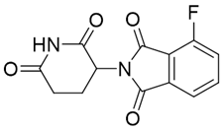
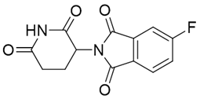
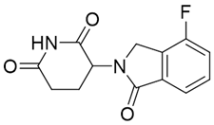
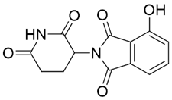
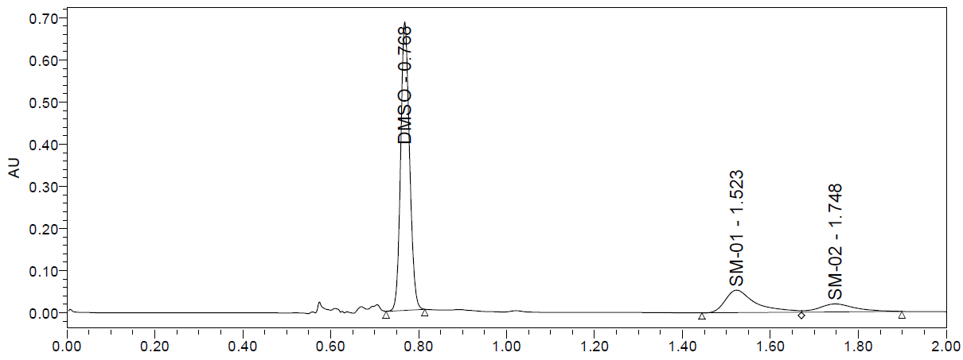
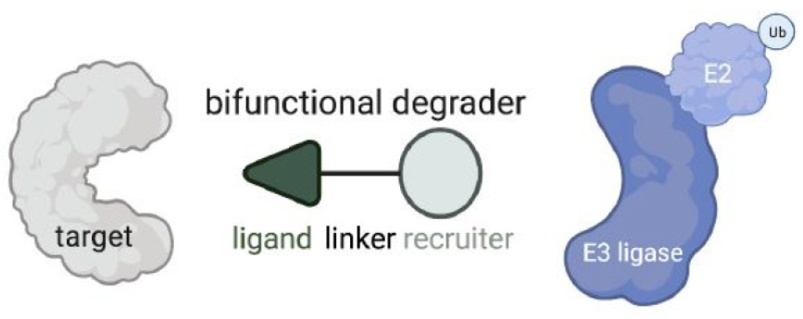
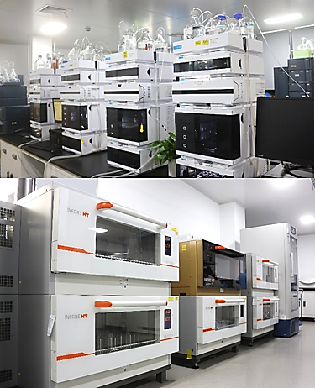
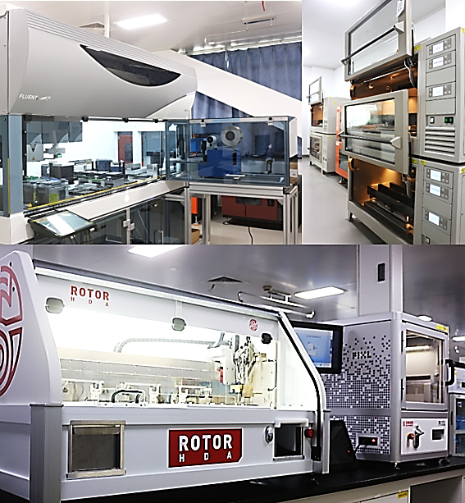
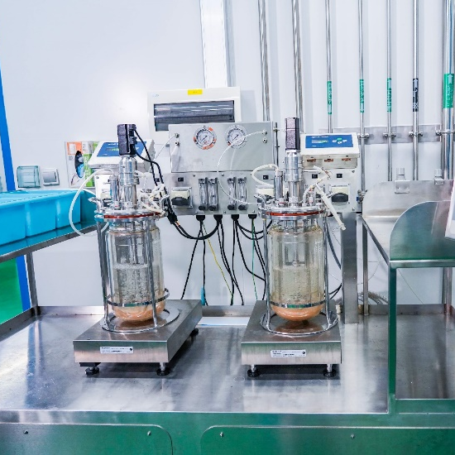
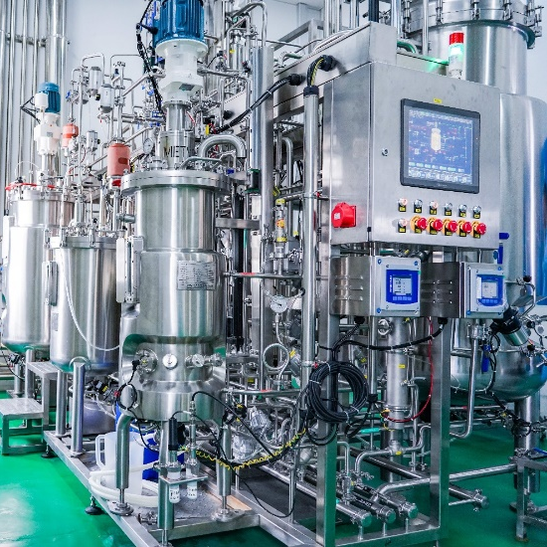
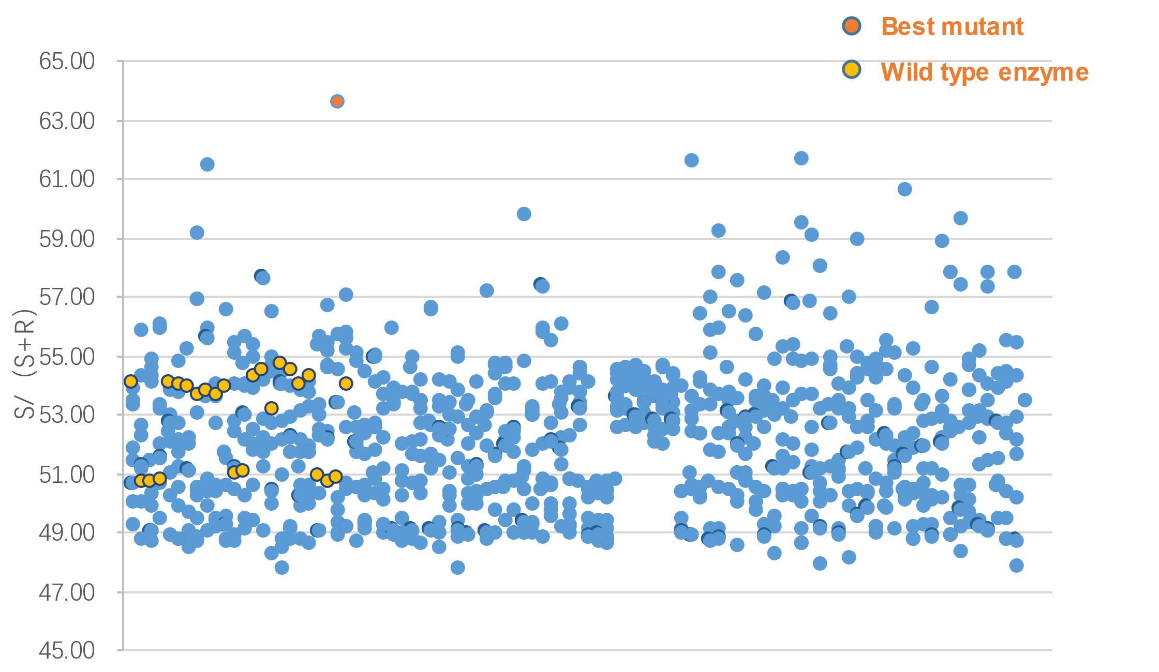
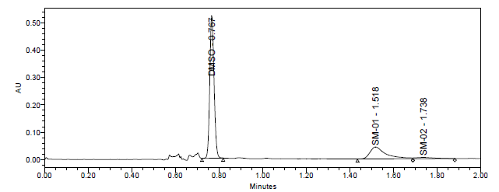
Enzyme-Catalyzed Enantioselective Hydrolysis of 3-Substituent-2,6-piperidinedione: An Important Approach to Preparation of Chiral Key Building Block of PROTACs
Joanna Dai, Fenglai Sun, Jie Li, Bingyao Sun, He Li
WuXi STA, a subsidiary of WuXi AppTec
CONTACT INFORMATION: Joanna Dai, API Process Development , WuXi STA, a subsidiary of WuXi AppTec E-mail: Joanna_dai@wuxiapptec.com
PURPOSE
The hydantoinase has been shown to catalyze hydrolysis of various racemic 3-substituted-2,6-piperidinediones. Enzymatic resolution showed that high enantioselectivity (92% ee) of 3-aminopiperidine-2,6-dione and 96% ee of 3-bromopiperidine-2,6-dione can be achieved with 96% and 98% of conversion, respectively, which can be used for the synthesis of chirally pure PROTACs, obviating SFC separation. This type of enzyme can be used to access more complex 3-substituent-2,6-piperidinediones, hence suitable for the late stage of PROTACs preparation at scale while avoiding epimerization during the synthesis.
Our goal was to develop a viable process for the production of 3-substituted-2,6-piperidinedione via biocatalysis approach. WuXi STA provides a one-stop enzyme platform, which consists of four major parts: enzyme screening, process R&D, enzyme evolution, and fermentation. For enzyme screening, we can perform more than 20 reaction types with 2000 wild-type enzymes and 100,000 mutants. For process R&D, we can carry out rapid process optimization, including enzyme immobilization. In 2022, we delivered 105 metric tons of compounds using enzymatic processes. In terms of enzyme evolution, we have high-throughput instruments to provide next generation sequencing service. The platform is capable of performing computation simulation for rational design. For enzyme manufacture, we can produce more than 100 kg of enzyme powder per week and we are able to conduct fermentation optimization and enzyme purification.
Results
Enzyme screening
30 enzymes were screened for preparation of 3-aminopiperidine-2,6-dione. Enzyme C3 gave 70% conversion and 40% ee.
Enzyme evolution
The wild-type enzymes did not meet our criteria for catalytic selectivity and activity. We conducted enzyme evolution by initially designing a mutation library. Our bioinformatics team at WuXi STA used proprietary software for enzyme structure design, then transformed the genes into E. coli, and mutants were picked by a colony picking robot. Once the enzymes were produced and cells grown in 96-well plate, substrates were added with a liquid handler. Then the samples were screened by high-throughput SFC or UPLC. The data was analyzed to identify mutants with better catalytic features. If the best mutant showed sufficient selectivity and activity, enzyme evolution would be terminated If the results were not sufficient, the next round of enzyme evolution would be conducted.
Here enzyme evolution for C3 was conducted to achieve higher performance. After one round of evolution, the best mutants gave 92% ee of 3-aminopiperidine-2,6-dione.
Upon enzyme evolution, the best mutant showed significant improvement. After further process development and scale-up, the reaction gave 96% of conversion and 92% ee.
We further developed the methodology for the below analogues, which are useful as key building blocks of PROTACs. Good chiral selectivity was obtained.
More interestingly, this enzymatic approach can also be used for more complicated molecules to give higher ee%, which is normally more difficult since the substrates for enzymatic reaction need have some solubility in water and can fit into the protein structures of enzyme. By this approach, one can build up this chiral center at the late stage of synthesis to avoid the epimerization during the downstream synthesis.
So far, the two chiral molecules are obtained by SFC and Prep-HPLC. The enzymatic approach can be used for future production.
Starting material | ee%
 | 96%
 | 75%
 | 85%
Starting material | ee%
 | 82%
 | 16%
 | 61%
Introduction
Proteolysis targeting chimeras (PROTACs) are heterobifunctional small molecules with three chemical components: a ligand binding to a target protein, another ligand binding to E3 ubiquitin ligase, and a linker for conjugating these two ligands. Today, the E3 ligase receiving the most attention is cereblon (CRBN) or its analogs.¹
Depending on the racemization rate of compounds in cell media, chiral or racemic PROTAC molecules are selected to be used in clinical trial. However, the chiral center of 3-substituted-2,6-piperidinedione presents a synthetic challenge. Expensive and unscalable methods, such as SFC and preparatory-HPLC, are still widely used to prepare the chiral drug substances for clinical development.²
Figure 3. Enzyme screening result
Figure 1. Reaction of hydantoinase.
Conclusions
In summary, we have demonstrated that hydantoinase can catalyze the hydrolysis of various of 3-substituted-2,6-piperidinedione with high enantioselectivity. This enzymatic method provides a practical solution to avoid SFC separation for this type of key building block of PROTACs, which can be further developed for scale up production.
Enzyme Screening
Enzyme Evolution
Process Development
Enzyme Fermentation
REFERENCE
Bridget P. Belcher, Carl C.Ward, and Daniel K. Nomura, Biochemistry, 2023, 62, 588-600.
BRISTOL-MYERS SQUIBB CO, WO2006/81251, 2006, A2.
Yafei Liu, Guochao Xu, Jieyu Zhou, Jie Ni, Lu Zhang, Xiaodong Hou, Dejing Yin, Yijian Rao, Yi-Lei Zhao, and Ye Ni ACS Catalysis 2020 10 (21), 12393-12402
Xu, GC., Li, L., Han, RZ. et al. Characterization and Soluble Expression of D-Hydantoinase from Pseudomonas fluorescens for the Synthesis of D-Amino Acids. Appl Biochem Biotechnol 179, 1–15 (2016).
20+ reaction types*
2,000+ in-house
enzymes
Next gen sequencing
1,000+ m² biochemistry
lab
Route scouting and
development
100+ enzyme processes
per year
Fermentation
optimization
>100 kg enzyme
powder/week
Figure 2. WuXi STA One-Stop CDMO Enzyme Platform
.
Figure 4. First round high throughput screening
Figure 5. Result after process development of enzyme route

