Slide 1
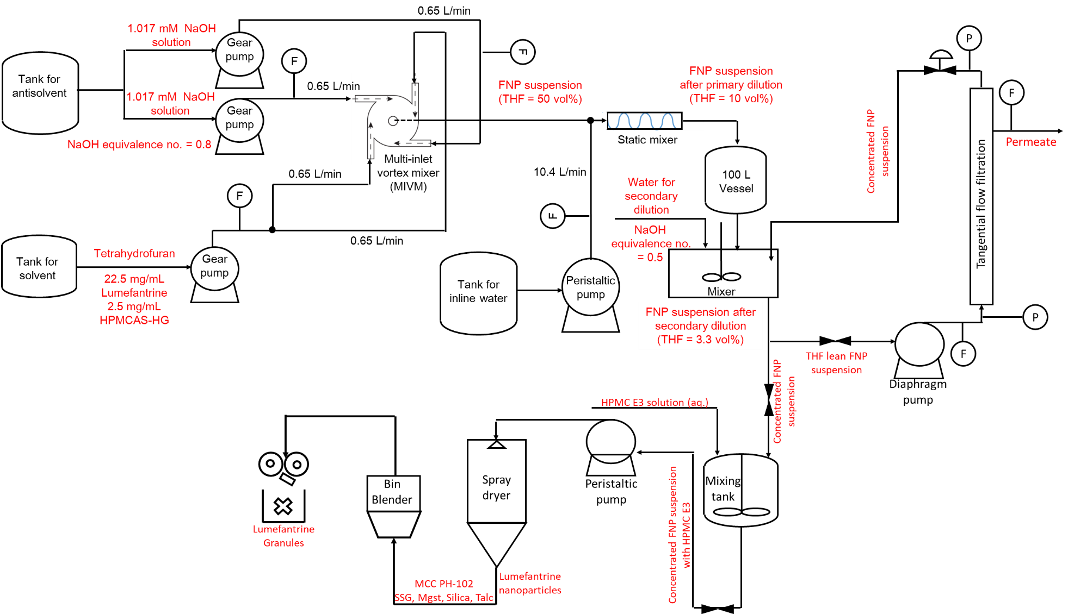
Scaled-up Production of High Drug Loading and Dissolution Enabling Lumefantrine Nanoparticles
Lirong Ma¹, Jiankai Yang¹, Santipharp Panmai¹, Yingyue Zhang², Chang Tian², Kurt Ristroph², Leon Wang², Madeleine Armstrong², Robert K. Prud'homme²
¹WuXi STA (A WuXi AppTec Company)
²Princeton University
CONTACT INFORMATION: Santipharp Panmai, Pharmaceutical Development Services, WuXi STA, A WuXi AppTec Company, Shanghai, China. E-mail: santipharp_panmai@wuxiapptec.com
PURPOSE
Lumefantrine (LUM) is an anti-malaria drug developed in the 1960s in China to address the increasing resistance of falciparum malaria to chloroquine and other previously used malaria drugs. The drug became available to the market in 2009 under the tradename Coartem where LUM is co-formulated with Artemether. However, due to the hydrophobic nature of LUM, it suffers from low bioavailability, and therefore a high number and frequency of dosages are required, increasing the risk of patient non-compliance. Patient non-compliance can lead to the development of anti-malarial drug resistance.
Given the above concerns, a scaled-up manufacturing process for LUM nanoparticles has been developed (based on the polymer-directed, rapid precipitation technique, Flash NanoPrecipitation). LUM nanoparticles produced were then formulated into LUM granules which have been shown to demonstrate enhanced bioavailability compared with the crystalline API and, therefore, serve as a potential new anti-malaria formulation to address the limitations of the current LUM drugs.
Results
Tangential flow filtration
The TFF step was necessary; otherwise, there would be a tremendous volume of suspension to be spray dried, making the manufacturing process uneconomical. A concentration factor of 17 was aimed for in the TFF step. After TFF, the concentration of LUM in the suspension was determined to be 12.75 mg/mL. The increase in the size of nanoparticles in the TFF step (as can be seen in Table 4) was caused by the intensive stress environment in the process, but the particle size still remained in the nanosize range.
Table 3 Process parameters for tangential flow filtration
Pore size (nm) | Surface area (m²) | Mean flux (L/m²﹒min) | Shear rate (min⁻¹) | TMP (bar)
100 | 0.24 | 15.6 | 12000 | 2.0
Table 4. Particle size, stability and pH for post TFF suspension
Methods
A schematic process flow diagram for the manufacturing process is presented in Figure 1.
Five unit operations are included in the manufacturing process, which are flash nanoprecipitation (FNP), tangential flow filtration (TFF), spray drying (SD), tumble blending (TB) and dry granulation (DG). LUM nanoparticles were made by flash nanoprecipitation process (FNP) in a multi-inlet vortex mixer (MIVM) designed in-house (Feng, 2019) and stabilised by HPMCAS HG. An in-line water stream and further external water addition were introduced to dilute the FNP suspension. The THF lean suspension was then passed through a tangential flow filtration (TFF) unit to separate the excess water from the suspension. Afterwards, the concentrated FNP suspension was mixed with a cryoprotectant (HPMC E3) before being spray dried to obtain LUM nanoparticles. The LUM nanoparticles obtained were further formulated into granules of LUM nanoparticles through a TB and DG process. The excipients selected include microcrystalline cellulose, sodium starch glycolate, magnesium stearate, colloidal silica, and talc. The granules were then packed in sachet for stressed stability studies at 40°C/75%RH.
 | d₅₀ (nm) | PDI | pH
Initial | 276.6 | 0.202 | 7.31
After 2 days | 467.8 | 0.164 | 6.99
After 3 days | 309.8 | 0.276 | 7.15
Spray drying
The concentrated FNP suspension was mixed with a 15 wt% HPMC E3 solution to obtain a mass ratio of 1:1 between nanoparticles and E3. LUM NPs prepared by this route demonstrated enhanced in-vivo bioavailability when compared with the original crystalline API.
Table 5. Process parameters for spray drying
Liquid inlet flow rate (mL/min) | Process gas |  |  |  | Nozzle gas
11 | Inlet temp (°C) | Flow rate (kg/h) | Pressure (bar) | Outlet temp (°C) | Flow rate (kg/h) | Pressure (bar)
 | 120 | 30 | 2.6 | 60 | 30 | 0.3
Table 6. Characterisation of spray dried final product
Redispersion |  | Dry powder
d₅₀ (nm) | PDI | Water content | Yield
452.2 | 0.242 | 4.77 | 58%
Figure 1. Schematic process flow diagram
Table 7. In-vivo results (Courtesy of Genentech)
Description | Vehicle | AUC_{last} (hr*µmol/L) | C_{max} (µmol/L)
Original API | 0.2% Tween in water | 2.29 | 0.487
Nanoparticles | DI Water | 9.74 | 2.1
Dry granulation
The nanoparticles were then formulated into a granule-in-sachet dosage form at a drug loading of 26%, via a TB and DG process. The parameters of the process and the results can be seen in Table 8. An accelerated stability programme was conducted on the final dosage form. In this study, the granular samples were found to generate consistent in-vitro dissolution behaviour (the formulated nanoparticles were noted to be far more soluble than the crystalline counterpart) and stable assay results, as can be seen in Figure 3.
Table 8. Process parameters and characterization of granules granules
Compaction |  | Milling | Characterisation
Pressure (kN) | Ribbon thickness (mm) | Mesh size | d₁₀ (μm) | d₅₀ (μm) | d₉₀ (μm)
5.0 | ~1.55 | #14 | 19.6 | 565 | 1590
Results
Flash nanoprecipitation
In the FNP step, two solvent streams and two antisolvent streams are mixed together to form nanoparticles containing Lumefantrine in the core and ionised HPMCAS shell in the outer surface. The size of nanoparticles formed also depended on the mixing speed in the MIVM and the solvent content in the suspension. At a Re ≈ 38000, with a two-stage dilution at a factor of 15, the 50 vol% THF content in the FNP suspension after MIVM was reduced to 3.3%. The particles formed displayed excellent particle size and prolonged stability.
Conclusions
In conclusion, a scaled-up manufacturing process to produce sachet dosage for high drug loading formulated granules of LUM nanoparticles has been built. The prototype formulation demonstrated enhanced in-vitro dissolution kinetics and consistent assay results in a 3M accelerated stability programme. A potential route to address growing concerns associated with low bioavailability of LUM can therefore be proposed.
Table 1. FNP flow rates and Re
Stream name | Flow rate (L/min) | n_{succinate} : n_{NaOH} | Re
THF 1 | 0.65 | 1:0.8 | 38144
THF 2 | 0.65
Anti-solvent 1 | 0.65
Anti-solvent 2 | 0.65
Table 2. Particle size, stability and pH before and after secondary dilution
Item | Assay results | XRPD results
Release | 27.6 | Unchanged from release
1 M | 27.7
3 M | 27.7
6 M | 27.4
 | d₅₀ (nm) | PDI | pH
Initial | 265.8 | 0.107 | 6.55
n_{succinate} : n_{NaOH} = 1:1.3
Initial | 265.8 | 0.114 | 7.31
After 1 day | 276.8 | 0.197 | 7.23
After 3 days | 290.9 | 0.119 | 7.10
Succinate group
Acetyl group
Figure 3. Stability results of formulated granules of Lumefantrine nanoparticles
Figure 2. HPMCAS-HG ionisation
REFERENCE
Feng, J., Zhang, Y., McManus, S.A., Qian, R., Ristroph, K.D., Ramachandruni, H., Gong, K., White, C.E., Rawal, A. and Prud'homme, R.K., 2019. Amorphous nanoparticles by self-assembly: processing for controlled release of hydrophobic molecules. Soft matter, 15(11), pp.2400-2410.
FUNDING
This work was funded by the Bill & Melinda Gates Foundation.

